Slide 1
RL Journal Club
Chapter 5 Continued
Monte Carlo Methods
Jonathan Dorsey & Ziquan Deng

Slide 2
Dynamic Programming
Monte Carlo Methods
Method:
Computes value functions by successive “complete” iterative sweep through the MDP via one step lookahead
Requires Model: (MDP must be known & defined)
Exploration: Has no exploration problems since the MDP must be given and DP iteratively evaluates ALL states
Efficiency: Computationally inefficient due to its exhaustive search methodology
Method:
Generate belief in what the value function is by “Sampling” random trajectories
Model Free: The addition of Q’s (action value func) enable Model free
Exploration: Due to dependence on sampling, exploring becomes an important issue to address
Exploring starts - Learns from starting in new positions
Epsilon- Soft Policy (π(a|s) >0 ∀ a ∈ 𝒜)
Efficiency: Stochastic sampling can be as accurate as desired (n ⇰ ∞), while being an efficient approximation

Slide 3
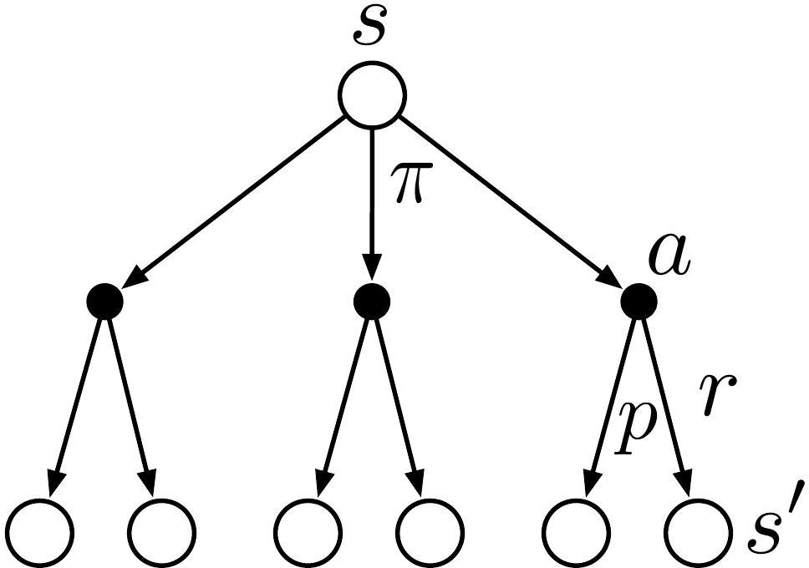
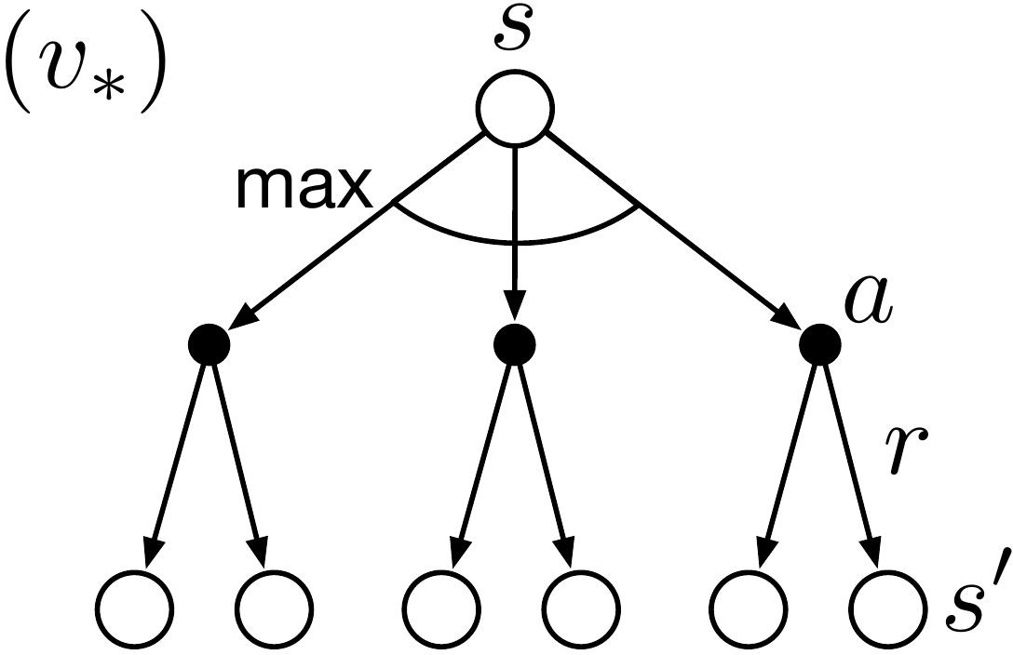
MC vs. DP
No bootstrapping
Estimates for each state are independent
Can estimate the value of a subset of all states
Monte Carlo
Dynamic Programming

Slide 4
Monte Carlo Corrections from Last Time
First-Visit/Every-Visit (CORRECTION - Every-Visit, is an easier & more general form which fits in to eligibility traces & function approximation)

Slide 5
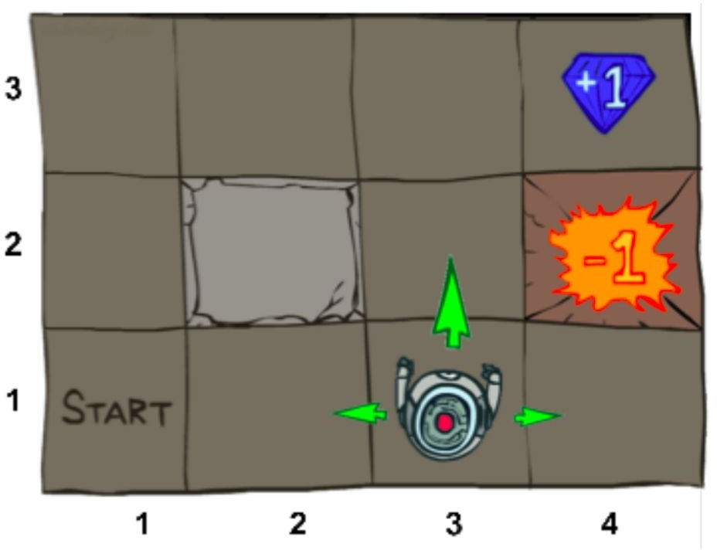
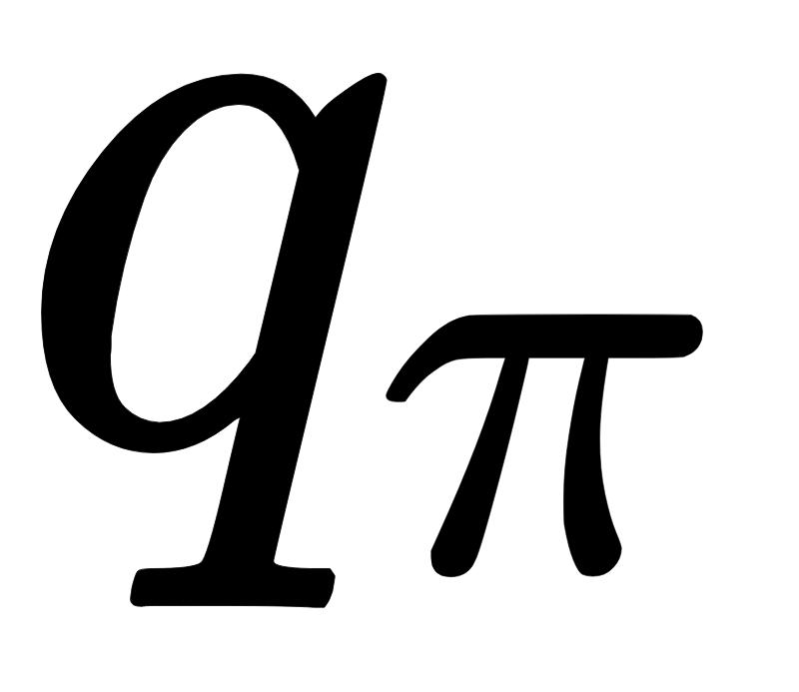
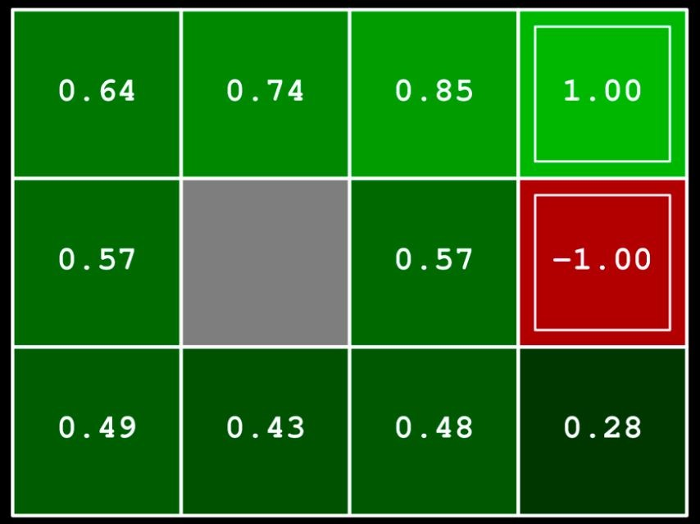
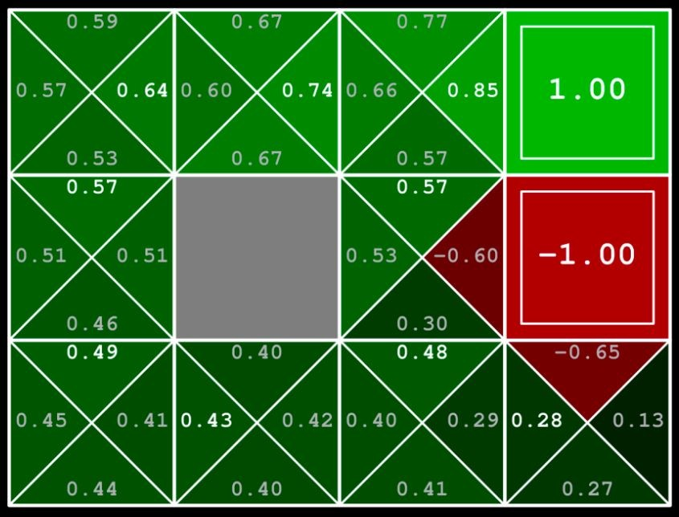
Monte Carlo Prediction:
More useful if model is not available
Can determine policy without model
Converges quadratically to when infinite samples
Need exploration: all state-action pairs need to be visited infinitely
https://www.youtube.com/watch?v=qaMdN6LS9rA

Slide 6
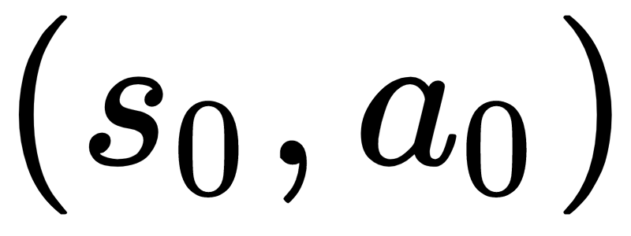
Exploring Starts (ES)
Specify state-action pair to start episode on
Cannot be used when learning from actual interactions

Slide 7
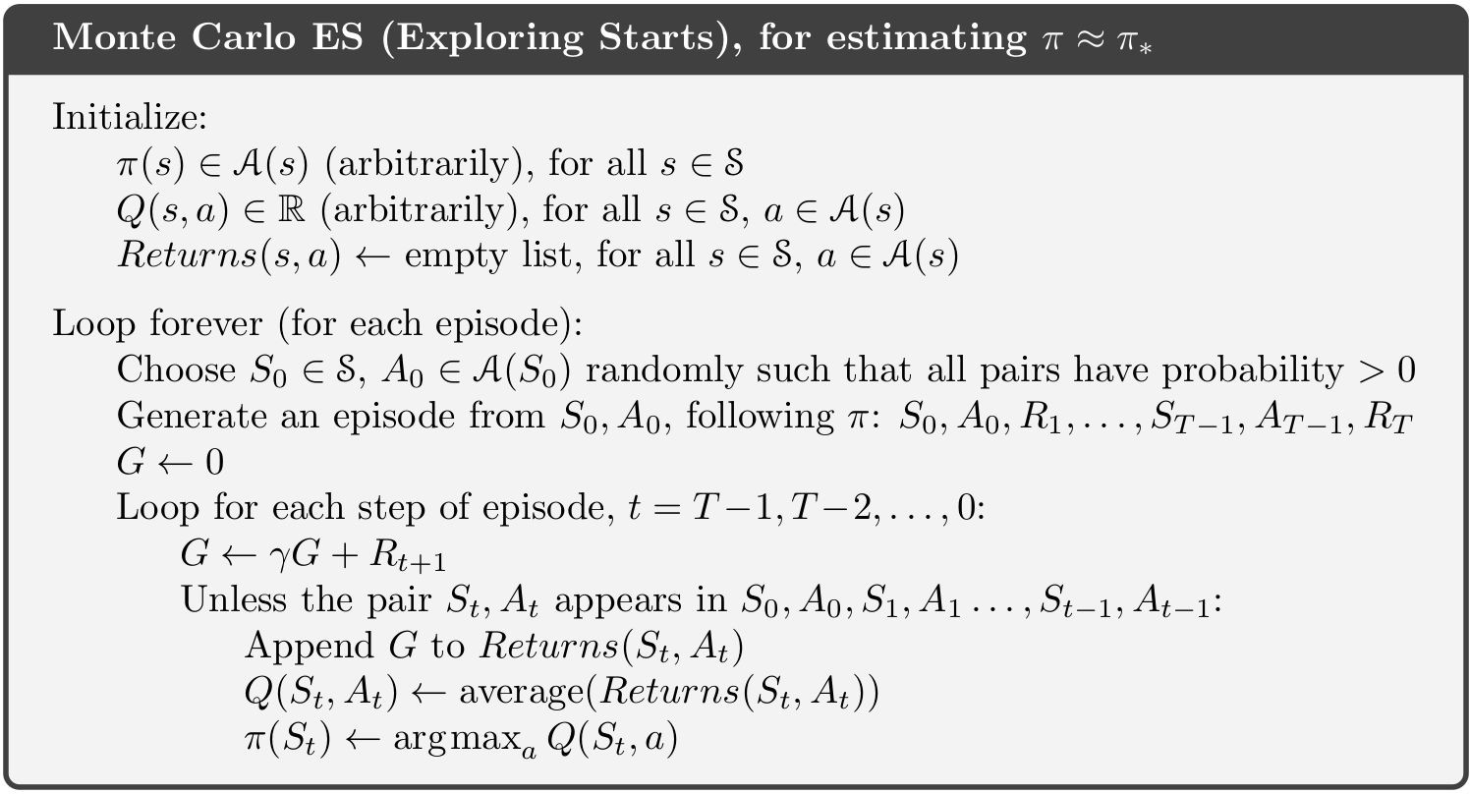
Monte Carlo ES Pseudocode

Slide 8
Monte Carlo ES
Control: approximate optimal policies
Use Generalized Policy Iteration (GPI)
Maintain approximate policy and approximate value function
Policy evaluation: Monte Carlo Prediction for one episode with start chosen by ES
Policy Improvement: Greedy selection\
No proof of convergence

Slide 9
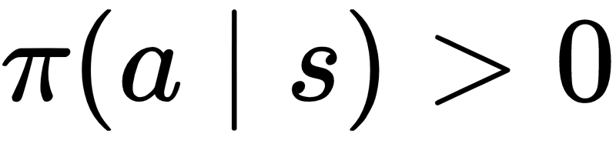
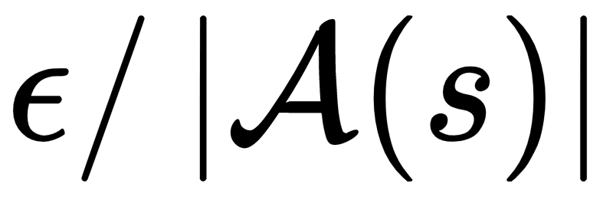
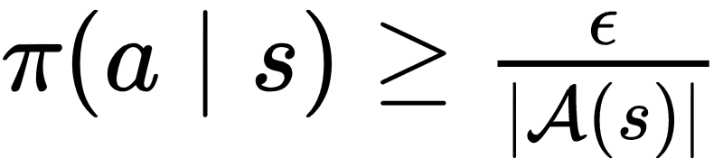
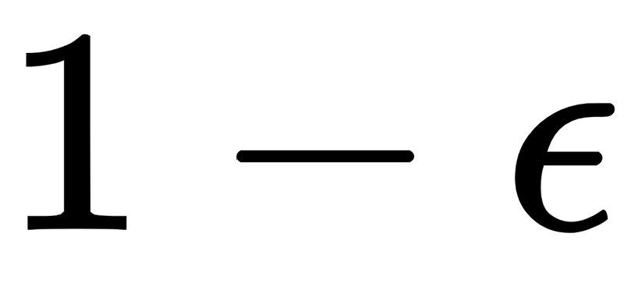

ε-soft Policy
Avoid exploring starts → Add exploration to policy
Soft policy: every action has nonzero probability of being selected
ε-soft policy: every action has at least
probability of being selected
ex) ε-greedy policy
Select greedily for probability
Select randomly for probability (including greedy)

Slide 10

ε-soft vs ε-greedy
ε-soft ε = 0.1
ε-greedy ε = 0.1
Random ε = 1
Greedy ε = 0
Softer

Slide 11
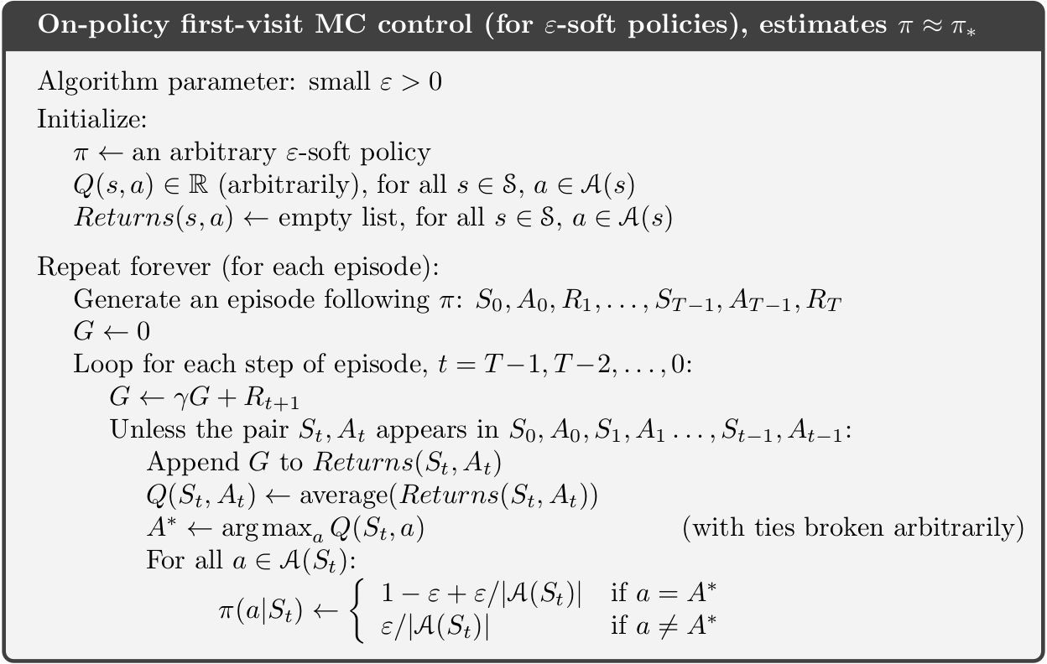
On-policy ε-soft MC control Pseudocode
On-policy: Evaluate / improve policy that is used to make decisions

Slide 12
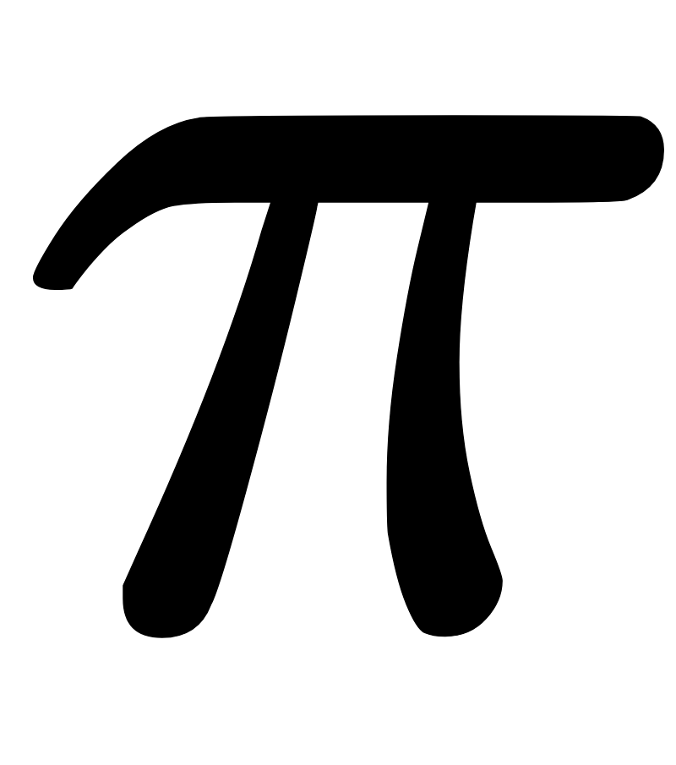

On-policy vs. Off-policy
On-policy: Evaluate / improve policy that is used to make decisions
Requires ε-soft policy: near optimal but never optimal
Simple, low variance
Off-policy: Evaluate / improve policy different from that used to generate data
Target policy : policy to evaluate
Behavior policy : policy for taking actions
More powerful and general
High variance, slower convergence
Can learn from non-learning controller or human expert

Slide 13

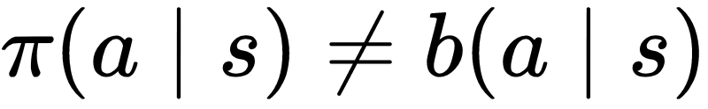
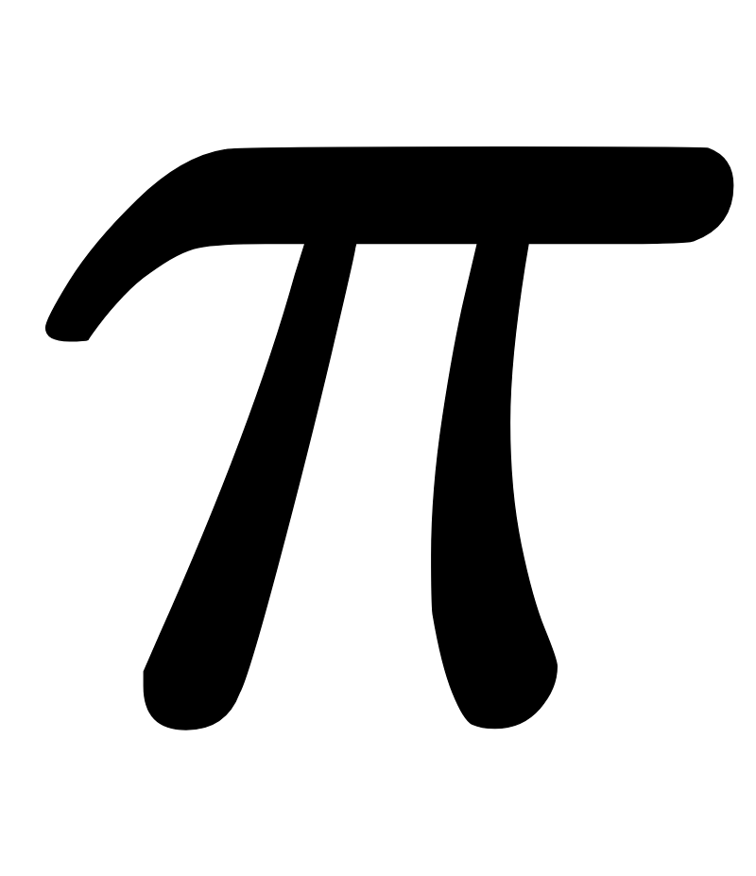

Coverage assumption for off-policy learning
To estimate values under , all possible actions of must be taken by
must be stochastic in states where

Slide 14
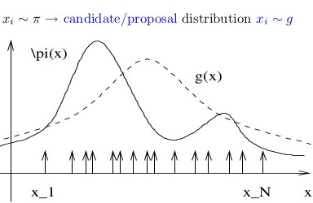
Importance Sampling - Crash Course

Slide 15
Motivation for Off-Policy Methods
& Importance Sampling
Almost all off-policy methods utilize importance sampling, in some fashion, because it is a means of relating two desirable quantities (target, behavior) policies
Importance Sampling is particularly well suited for “sample based” algorithms such as Monte Carlo Learning, where sampling is the primary mechanism for learning.

Slide 16
Off-Policy & Importance Sampling - Intuition
Any policy can be model stochastically. Even deterministic policies are merely stochastic with a probability of 100% chance of occuring
Off-Policy desires to implement a “different” policy to improve the performance of the algorithm, than the policy used explicitly in the “control” sense.
Importance Sampling, allows the user to bridge the “training” policy to the “control” policy by relating the relative weight (or IMPORTANCE) of one policy against the other.

Slide 17
Quick Overview of Importance Sampling
Importance Sampling is a statistical “Variance Reduction Technique”
Heavily used in applications like Monte Carlo integration for stochastic approximations (Building blocks for Particle Filters / Estimation Algorithms)
Importance Sampling enables faster computation of more reliable outputs
Bridges the gap between the “training” policy and the “control” policy
Comes in many flavors
Ordinary vs Normalized (standard types of Importance Sampling )

Slide 18




Monte Carlo Integration Problem
Goal: Use Monte Carlo Integration to evaluate some high dimensional integral which would be prohibitively expensive to compute using standard deterministic “numerical methods”
Suppose y is a vector of high dimension.

Slide 19
Importance Sampling - The Problem
Want to perform MC integration on a PDF which is difficult to randomly sample from but which we can evaluate at any given point.
There exist PDF which we can easily & efficiently sample from. Can we leverage this capability to solve the problem above.

Slide 20





Importance Sampling

Slide 21
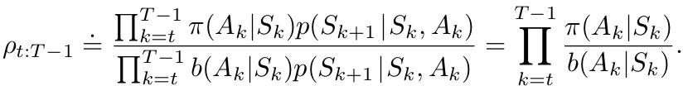
Importance Sampling
Trajectories have different probabilities under different policies
Estimate expected value from one distribution given samples from another
Weight returns by importance sampling ratio
Relative probability of trajectory occurring under the target and behavior policies
This provides us a means to relate our

Slide 22
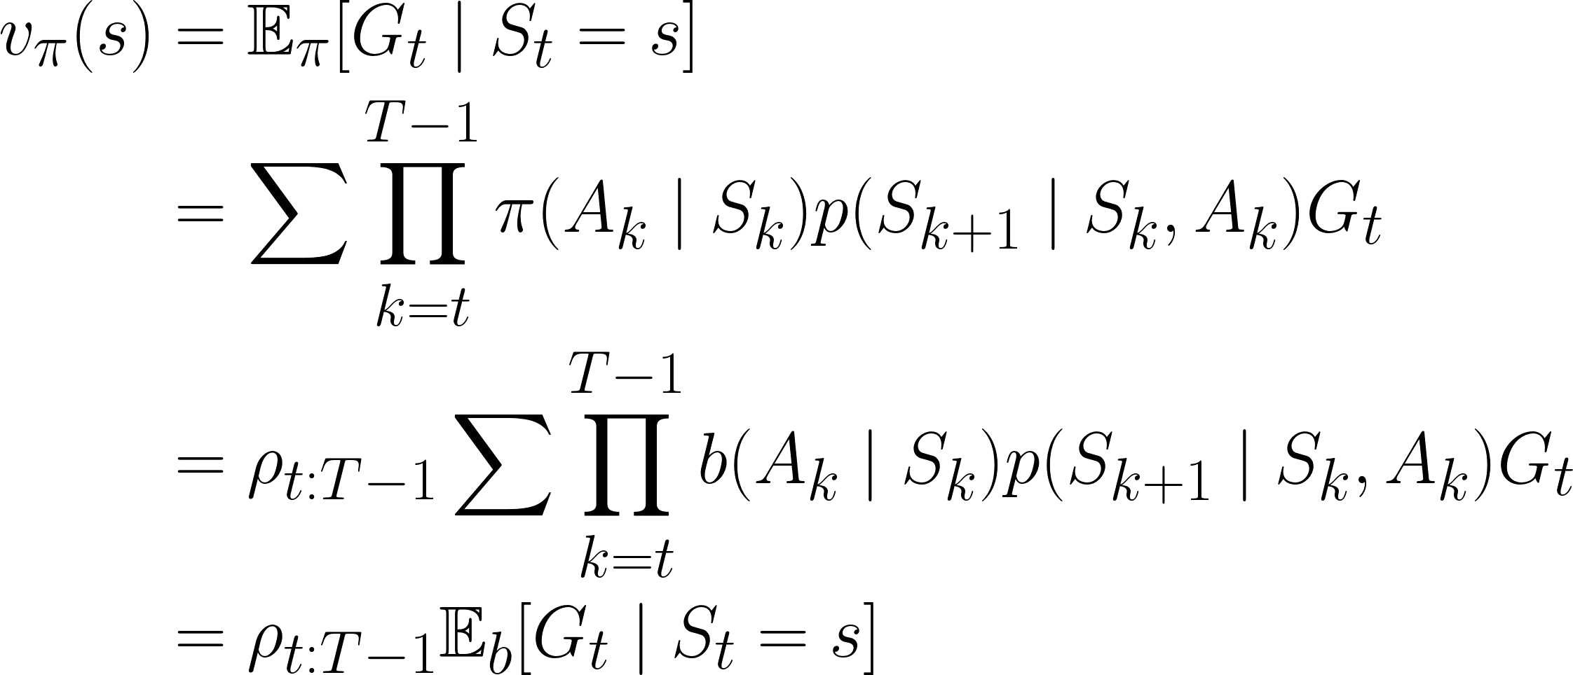
Ordinary Importance Sampling: Zero Bias

Slide 23
Importance Sampling - Takeaways
If you want to perform off-policy Monte Carlo RL, take the time to learn what Importance Sampling is and how it is being applied to the problem of MC Control.

Slide 24


